Slide 1

The Debugger's Quiz Game
Welcome to our presentation! We are Team Debugger's from Sandip University. Our project focuses on making learning fun through a gamified quiz experience.
TEAM MEMBERS :-
Prajwal Sunil Desale
Kartik Rajendra Patil
Akshay Ashok Desale
Sujan Arun Kalgude

Slide 2
Problem Statement : Gamify – Create Quiz
Project Overview :
DebuggersQuiz is a web-based educational game designed to help college students learn and test their knowledge in various subjects. The game will feature:
Multiple-choice quizzes.
Interactive learning modules.
A scoring system and leaderboard.
User authentication to save progress (optional)

Slide 3
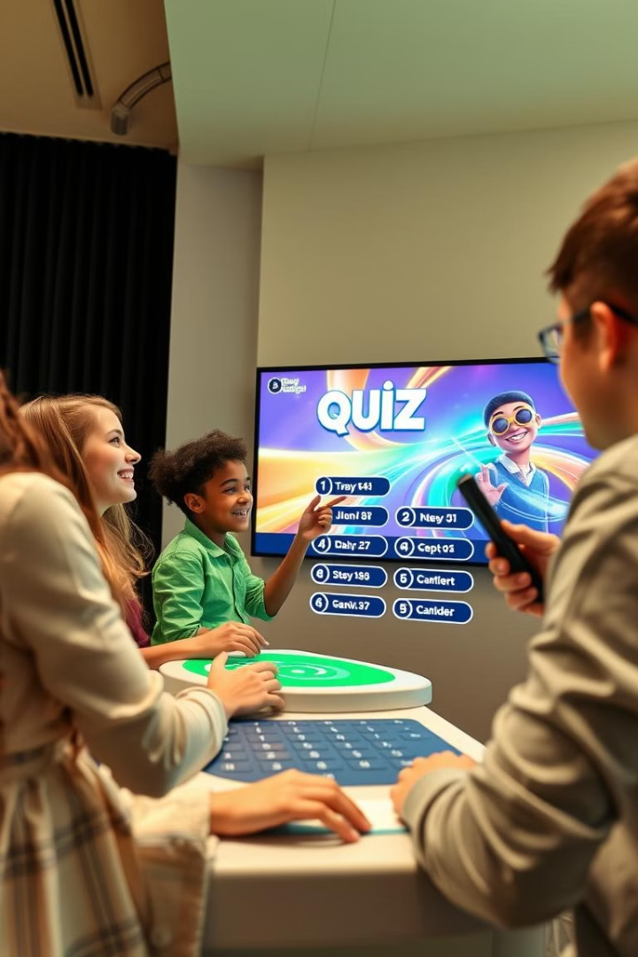
Gamify Quiz: Interactive Learning
1
Engaging Quizzes
Interactive quizzes boost motivation. Quizzes enhance participation and retention.
2
Fun Experience
Gamification elements transform learning. Learning becomes enjoyable and memorable.

Slide 4
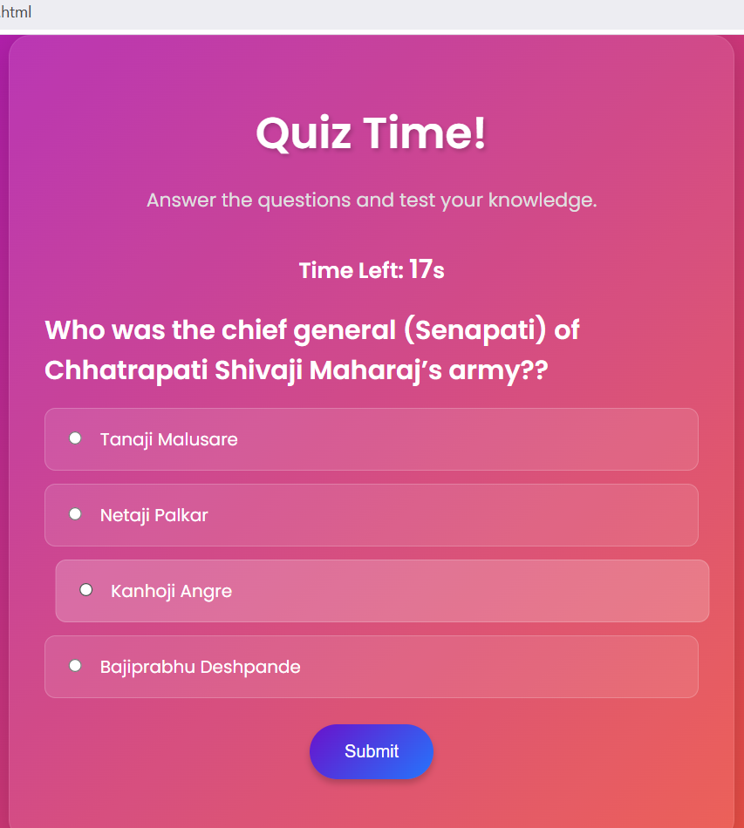
Real-Time Quiz: Points
1
Quiz Access
Participants join the quiz after the Registration has been Completed.
2
Live Scoring
Points are awarded for correct answers. This encourages quick and accurate responses.
3
Countdown Limit
On every question there is a time limit at least 20 seconds. If that times gets out then it shuffle to new another question.

Slide 5





Tech Stack: Used Tools and Languages
VS Code
HTML, CSS
JavaScript
Python
Primary code editor for development.
Creating structure and design.
Adding interactivity and functionality.
Backend logic and quiz management.
MySQL
Data storage and management.

Slide 6



Expected Outcomes: Enhanced Learning
2
Knowledge Retention
1
Increased Engagement
Active Participation
3
We anticipate students will be more engaged. They should show increased knowledge retention through our gamified quiz system. Active participation will become the norm.

